Slide 1


Department of Data Science
"Augmenting Clinical Data Using Synthetic IoMT Signals to Enhance Chronic Disease Prediction"
Presented By: Qasim Zafar
2024(S)-MS-DS-05
Supervisor: Dr. M. Junaid Arshad
University of Engineering and Technology, Lahore

Slide 2
Agenda
Introduction
Literature Review
Research GAP
Problem Statement
Work flow or Future use
Expected Outcome
Referances

Slide 3
Introduction.
Early detection of chronic diseases like diabetes is vital for effective treatment, yet traditional datasets (e.g., Pima Indians) often lack real-time physiological data, limiting their diagnostic accuracy [9].
Wearable IoMT devices provide continuous signals such as ECG, heart rate, and body temperature, which can enhance disease prediction [10]. However, real IoMT data is scarce due to privacy concerns and data inconsistencies [6], [7].
To address this, the proposed research explores “Augmenting Clinical Data Using Synthetic IoMT Signals”, generating realistic synthetic physiological signals using AI-based models (e.g., GANs) [4], [5]. These signals will be integrated with clinical data to train AI systems that aim to improve prediction accuracy, reliability, and ethical data use in healthcare applications.

Slide 4
Literature Review
Year | Title & Authors | Research Purpose | Model | Dataset / Statistics | Evaluation Measures | Limitations & Research Gap
2025 | Enhancing Chronic Disease Prediction in IoMT-Enabled Healthcare 5.0 Using Deep Machine Learning [1]. | To improve Alzheimer’s disease prediction using IoMT-enabled deep learning with U-Net segmentation. | U-Net for segmentation, ResNet-101 for classification (transfer learning). | MRI data segmented by U-Net, categorized into 4 Alzheimer classes. | Accuracy (96.06%), ANOVA, t-tests, category-wise breakdown. | Focuses only on Alzheimer's; generalizability across diseases not fully validated.
2024 | Internet of Medical Things (IoMT) Enabled Intelligent System for Chronic Disease Prediction Using Deep Machine Learning [2]. | To predict knee osteoarthritis using X-ray images and IoMT-enabled deep machine learning. | ResNet-18 with transfer learning. | X-ray image dataset for knee osteoarthritis; 98.26% training, 95.79% validation accuracy. | Training/validation accuracy, patient-specific prediction efficacy. | Limited to KOA and image-based data; lacks broader chronic disease comparison.
2024 | Augmenting Internet of Medical Things Security: Deep Ensemble Integration and Methodological Fusion [3]. | To improve IoMT network security via ensemble deep learning for intrusion detection. | Transformer, DCNN, LSTM + Meta-learner ensemble. | WUSTL-EHMS-2020 and CICIoMT2024 datasets; 99-100% accuracy reported. | Accuracy, feature selection validation, robustness via ensemble classification. | Security-focused; doesn't contribute to medical diagnosis, focuses on intrusion detection.
2021 | Synthetic data in ML for medicine [4]. | Evaluate how synthetic data supports ML in healthcare | Various GAN-based techniques | Not specific – general review across healthcare datasets | Privacy, accuracy, utility trade-offs | Need for domain-specific benchmarks; limited clinical testing
2017 | Real-valued Medical Time Series Generation [5]. | Generate realistic medical time-series with GANs | Recurrent Conditional GAN (RCGAN) | ICU dataset from PhysioNet | Visual similarity, classifier performance | Generalization issues; lacks real-time validation

Slide 5
Literature Review
Year | Title & Authors | Research Purpose | Model | Dataset / Statistics | Evaluation Measures | Limitations & Research Gap
2019 | Data privacy in healthcare [6]. | Survey privacy-preserving methods in health data | Differential Privacy, Homomorphic Encryption, FL | General scope – not specific dataset | Data utility, privacy leakage metrics | High computational cost; lacks real-world validation
1988 | Forecasting diabetes with ADAP [9]. | Predict diabetes onset using clinical features | ADAP Learning Algorithm | PIMA Indians Diabetes Dataset (768 samples) | Accuracy, Sensitivity, Specificity | Outdated dataset; lacks modern sensor data
2020 | Federated ML in medical imaging [7]. | Introduce FL for privacy-preserving medical imaging | Federated Learning, Secure Multiparty Computation | Various imaging modalities (MRI, CT) | Model accuracy, communication efficiency | Lack of large-scale deployments; data distribution dependency
2022 | Survey on synthetic data generation [11]. | Survey methods for synthetic data and privacy preservation | GANs, VAEs, DP-based synth generators | Diverse dataset types: text, tabular, images | Utility metrics, privacy leakage, realism | Few works validate on real-world healthcare use-cases

Slide 6
Research GAP
Existing clinical datasets like the Pima Indians Diabetes dataset lack real-time physiological signals such as ECG, heart rate, and temperature, limiting prediction accuracy [9].
Real-world IoMT data is difficult to collect due to privacy issues, device diversity, and inconsistent sampling methods [6], [7].
Few studies explore the fusion of synthetic IoMT signals with clinical data for chronic disease prediction [4], [5].
There is limited research on the ethical use, accuracy, and generalization of AI models trained on synthetic health data [8], [11].

Slide 7
Problem Statement
This research aims to address the limitations of traditional clinical datasets by developing an AI-based framework that integrates synthetic IoMT signals (ECG, heart rate, temperature) with clinical data to enhance chronic disease prediction.

Slide 8
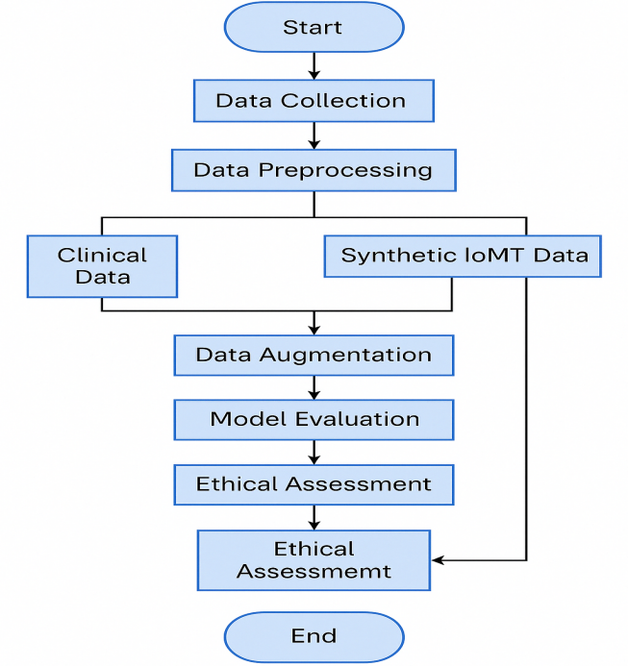
Work flow

Slide 9
Research Objective
To evaluate the limitations of traditional clinical datasets (e.g., Pima Indians) in predicting chronic diseases due to the absence of real-time physiological signals [9].
To develop synthetic IoMT signals (ECG, heart rate, temperature) using generative models such as GANs, and assess their realism and clinical relevance [4], [5].
To build and train AI models that fuse clinical and synthetic IoMT data for improved prediction of chronic diseases, particularly diabetes [10], [12].
To compare the performance of models trained on clinical data vs. augmented datasets using standard evaluation metrics like accuracy, F1-score, and ROC-AUC [11].
To address privacy, ethical, and deployment concerns related to synthetic health data and propose secure, responsible AI integration into healthcare systems [6], [8].

Slide 10
Expected Outcome
AI models trained on the augmented dataset (clinical + synthetic IoMT signals) will be evaluated using metrics such as accuracy, precision, recall, F1-score, and ROC-AUC to assess diagnostic effectiveness [10], [11].
The framework aims to produce interpretable and reliable predictions for early detection of chronic diseases like diabetes [4], [5].
Outcomes will contribute to privacy-preserving, AI-driven healthcare solutions, supporting real-world deployment in clinical decision-making [6], [8].

Slide 11
Referances
[1] Javed, A. R., Sarwar, M. U., Rizwan, M., Iqbal, F., Ashraf, I., & Beg, M. O. (2025). Enhancing Chronic Disease Prediction in IoMT-Enabled Healthcare 5.0 Using Deep Machine Learning: Alzheimer’s Disease as a Case Study. Computers, Materials & Continua, 74(1), 1699–1715. https://doi.org/10.32604/cmc.2025.045233
[2] Javed, A. R., Sarwar, M. U., Rizwan, M., Iqbal, F., Gadekallu, T. R., & Alazab, M. (2024). Internet of Medical Things (IoMT) Enabled Intelligent System for Chronic Disease Prediction Using Deep Machine Learning. IEEE Transactions on Industrial Informatics, 20(2), 1251–1259. https://doi.org/10.1109/TII.2023.3290000
[3] Naeem, H., Javed, A. R., Rizwan, M., & Jalil, Z. (2024). Augmenting Internet of Medical Things Security: Deep Ensemble Integration and Methodological Fusion. Computers, Materials & Continua, 78(1), 143–160. https://doi.org/10.32604/cmc.2024.041203
[4] Chen, R. J., Lu, M. Y., Chen, T. Y., Williamson, D. F. K., & Mahmood, F. (2021). Synthetic data in machine learning for medicine and healthcare. Nature Biomedical Engineering, 5(6), 493–497.
[5] Esteban, C., Hyland, S. L., & Rätsch, G. (2017). Real-valued (Medical) Time Series Generation with Recurrent Conditional GANs. arXiv preprint arXiv:1706.02633.
[6] Guan, Y., Lv, Z., & Zhou, H. (2019). A review of research on data privacy preserving in healthcare. IEEE Access, 7, 154182–154192.

Slide 12
Referances
[7] Kaissis, G. A., Makowski, M. R., Rückert, D., & Braren, R. F. (2020). Secure, privacy-preserving and federated machine learning in medical imaging. Nature Machine Intelligence, 2(6), 305–311.
[8] Rieke, N., Hancox, J., Li, W., Milletari, F., Roth, H. R., Albarqouni, S., ... & Cardoso, M. J. (2020). The future of digital health with federated learning. NPJ Digital Medicine, 3(1), 1–7.
[9] Smith, J. W., Everhart, J. E., Dickson, W. C., Knowler, W. C., & Johannes, R. S. (1988). Using the ADAP learning algorithm to forecast the onset of diabetes mellitus. In Proceedings of the Annual Symposium on Computer Application in Medical Care (pp. 261–265).
[10] Wang, L., Zhang, Y., & Li, Q. (2021). Wearable sensors for real-time health monitoring: Current status and future challenges. Sensors, 21(12), 3796.
[11] Xu, J., Wang, S., Wang, H., & Cao, Y. (2022). A survey on synthetic data generation for machine learning and privacy preservation. ACM Computing Surveys (CSUR), 55(2), 1–38.
[12] Zhang, Z., Pi, Z., & Liu, B. (2020). Data fusion in wearable sensors for health monitoring: A review. Sensors, 20(2), 421.

